Slide 1
Welcome to my presentation
Made by:
AMAN SINGH
ABHINAV CHAUDHARY
MAHAK GUPTA
ANUSHKA GOEL

Slide 2
TABLE OF CONTENT
OBJECTIVE
INTRODUCTION
DESCRIPTION OF MODULES
RESULTS(OUTPUT SCREEN)
REFERENCES

Slide 3
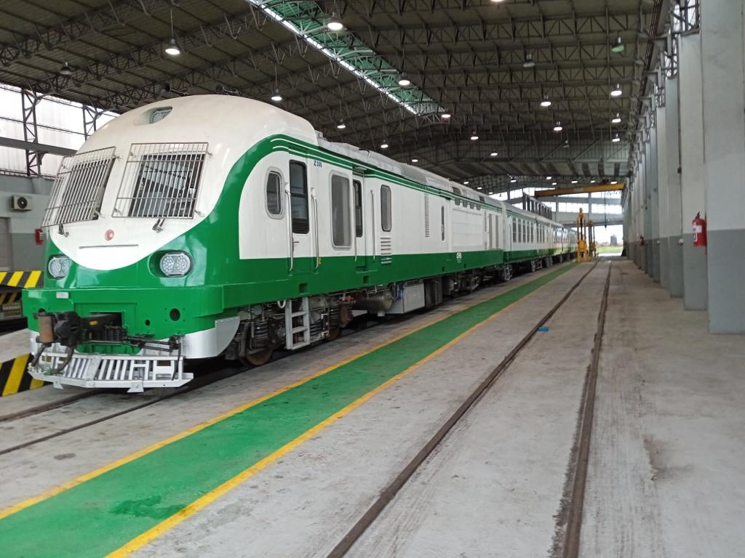
OBJECTIVE
A RAILWAY TICKET RESERVATION website is a website that provides travel reviews, trip fares, or a combination of both. Over 1.5 billion people book travel per year, 70% of which is done online.
The purpose of travel sites is to provide information related to local or international tourists’ destinations. When you are planning trips to where you are not familiar with, you may need to look into them. Travel sites are a platform to displace destination management companies that provides local travel services. you can reserve transportation, day tour services, restaurants, hotels, etc.

Slide 4

INTODUCTION
In simple words, Travel is the moving of objects or people between two geographical locations of relative distance. At times Introduction to Travel can also include movements between different destinations with short stop over's on the way to the final destination to be reached. But in the modern era, the significance of Travel has taken a center stage be it in terms of vacations and holidays or Business Travel and Cargo.

Slide 5
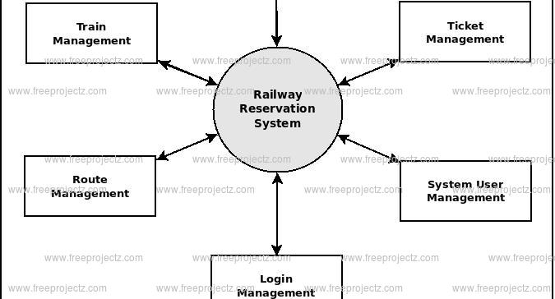
FLOW CHART/DFD

Slide 6
DESCRIPTION OF MODULES
HTML
The Hyper Text Markup Language or HTML is the standard markup language for documents designed to be displayed in a web browser It can be assisted by technologies such as Cascading Style Sheets (CSS) and scripting languages such as JavaScript.
Web browsers receive HTML documents from a web server or from local storage and render the documents into multimedia web pages. HTML describes the structure of a web page semantically and originally included cues for the appearance of the document.

Slide 7

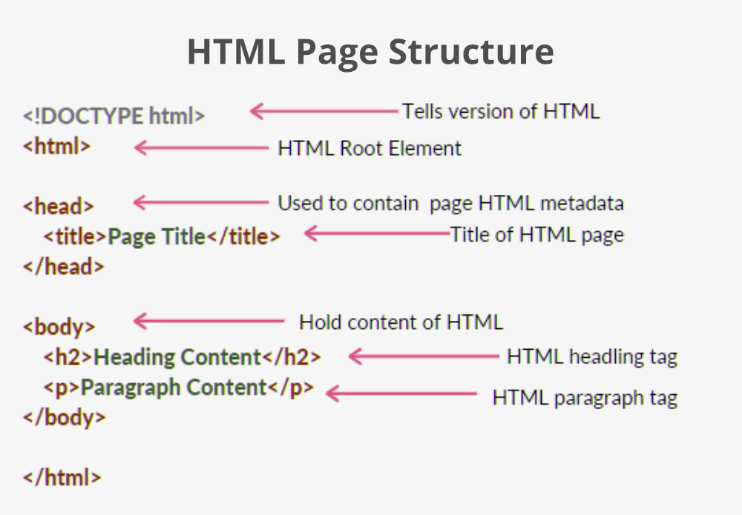

Slide 8
CASCADING STYLE SHEETS
Cascading Style Sheets (CSS) is a style sheet language used for describing the presentation of a document written in a markup language such as HTML or XML (including XML dialects such as SVG, Math ML or XHTML).CSS is a cornerstone technology of the World Wide Web, alongside HTML and JavaScript.

Slide 9

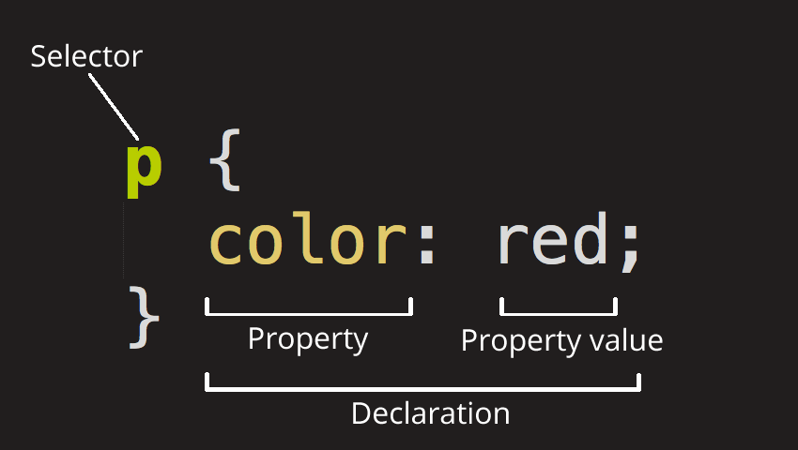

Slide 10
JAVASCRIPT
JavaScript is a high-level, often just-in-time compiled language that conforms to the ECMA Script standard.] It has dynamic typing, prototype-based object-orientation, and first-class functions. It is multi-paradigm, supporting event-driven, functional, and imperative programming styles. It has application programming interfaces (APIs) for working with text, dates, regular expressions, standard data structures, and the Document Object Model (DOM).

Slide 11

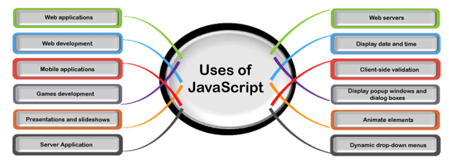

Slide 12
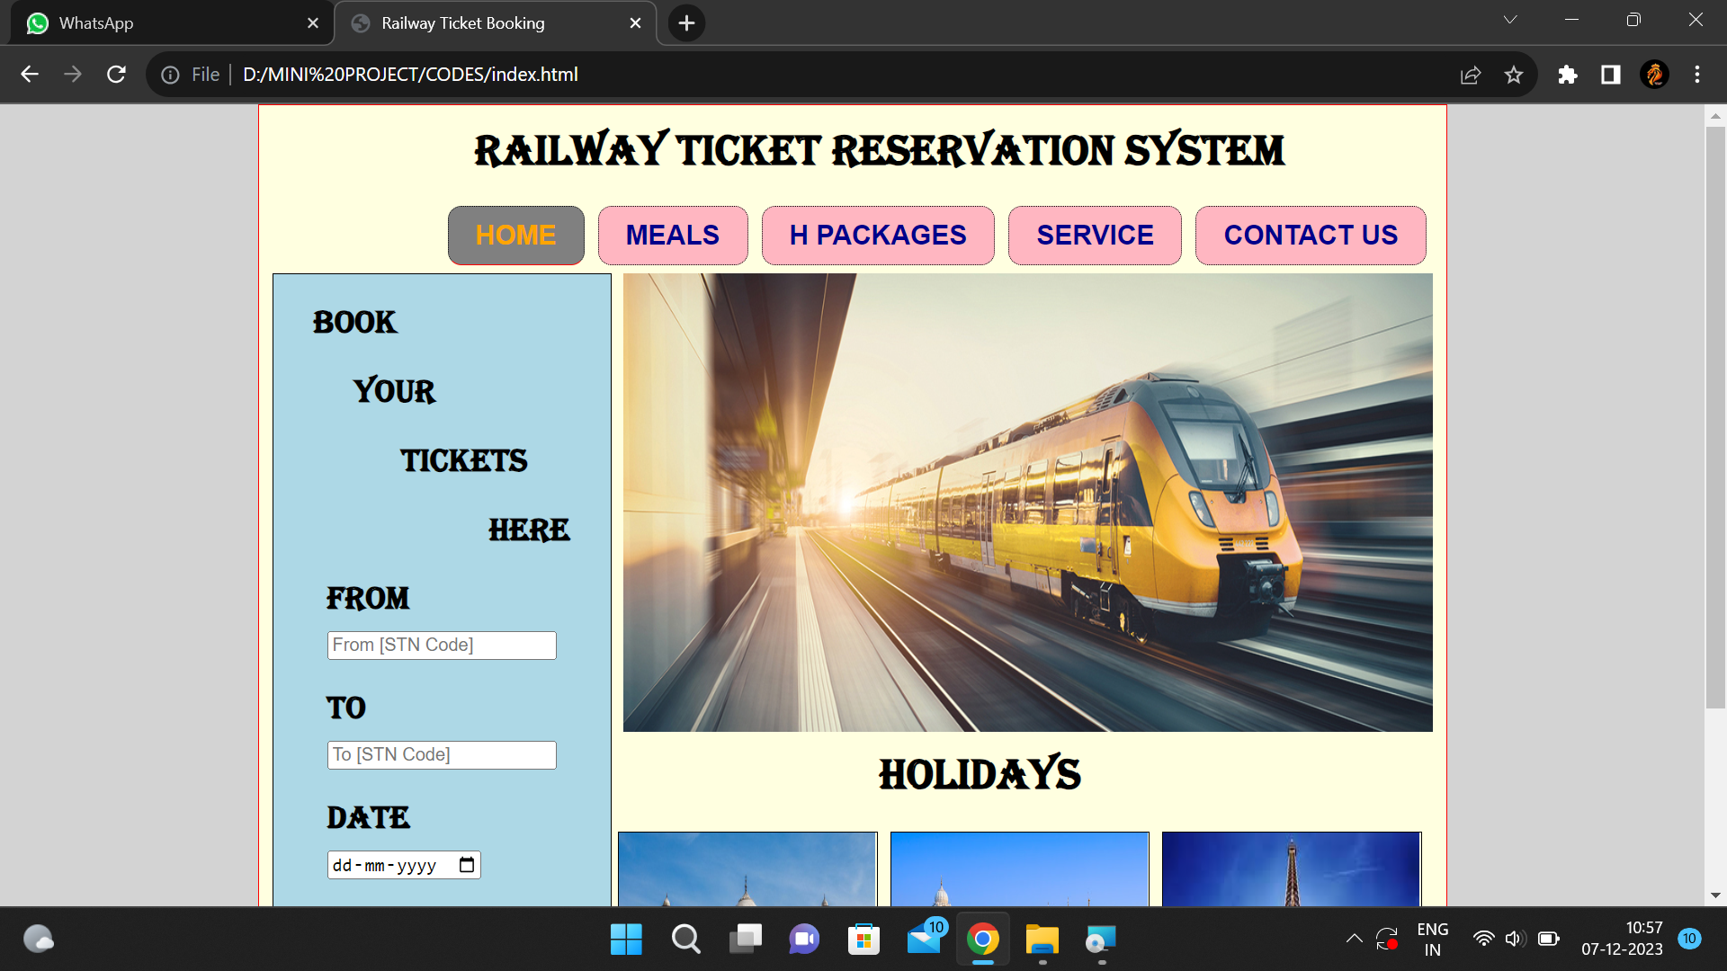
RESULTS/OUTPUT SCREEN

Slide 13
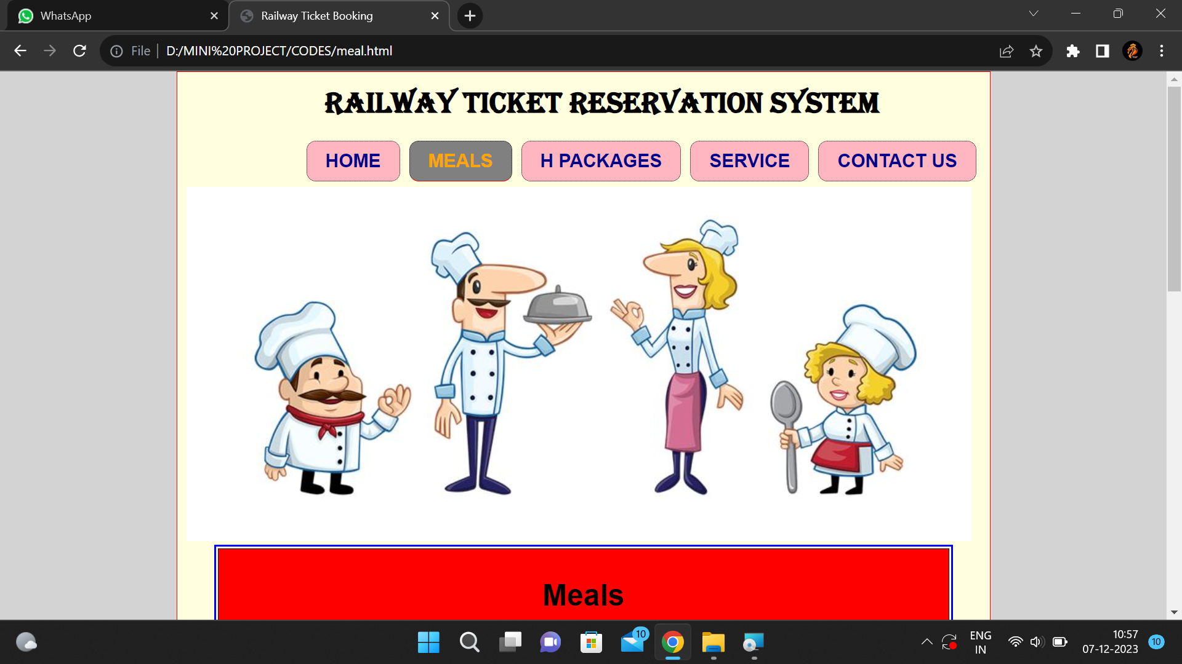

Slide 14
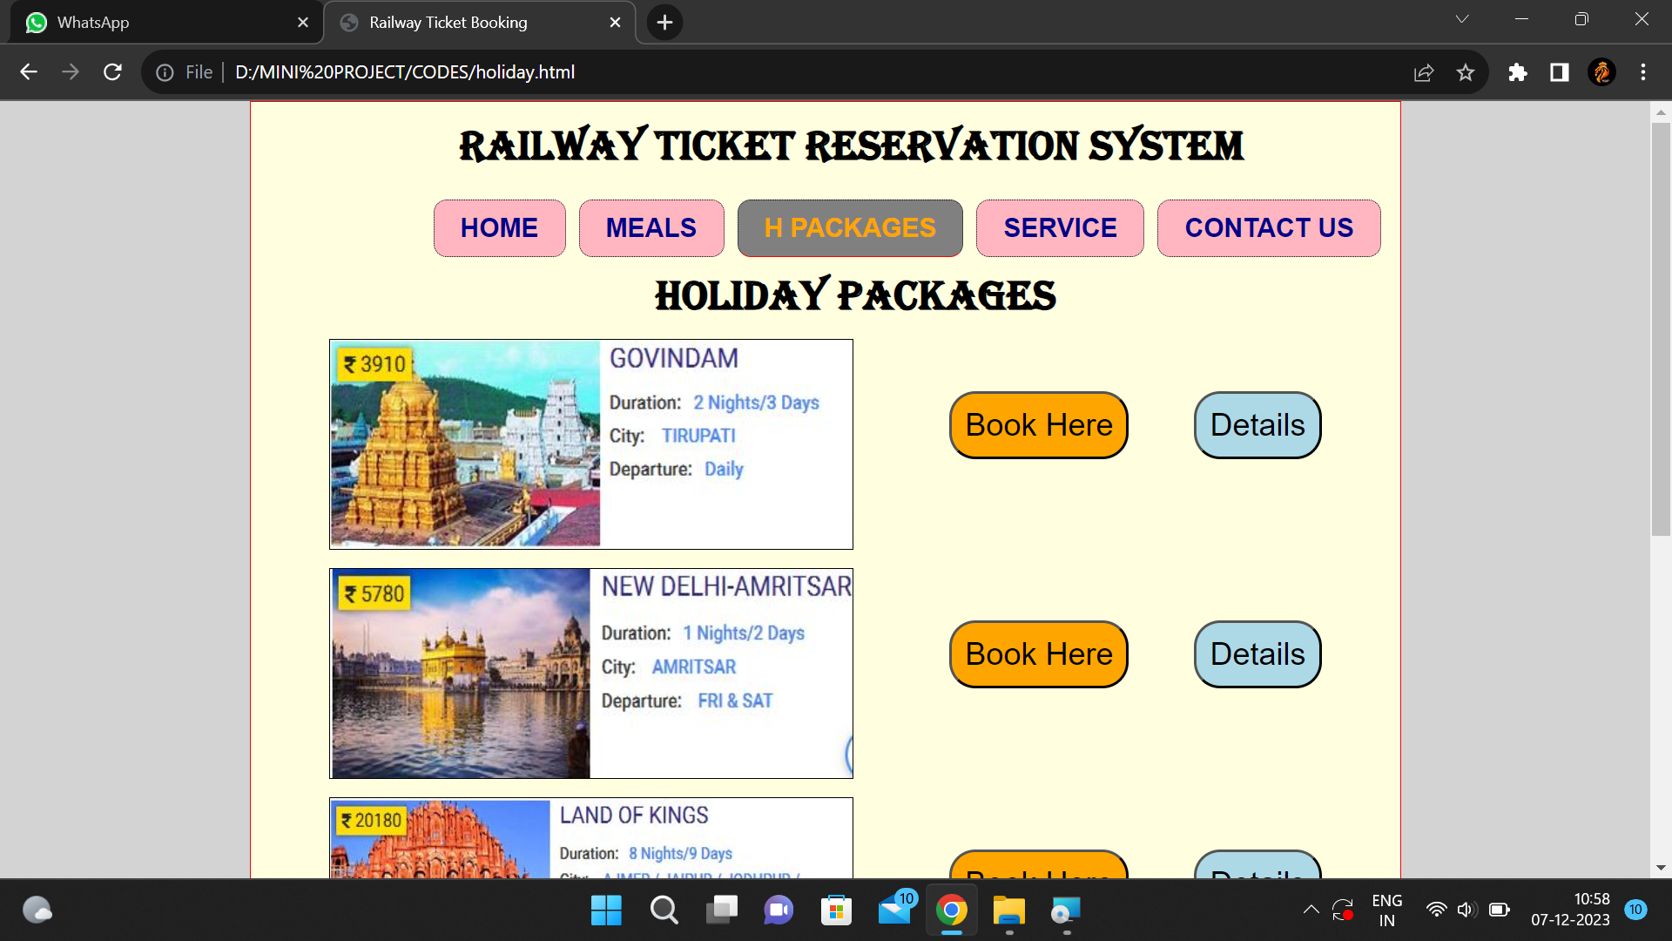

Slide 15
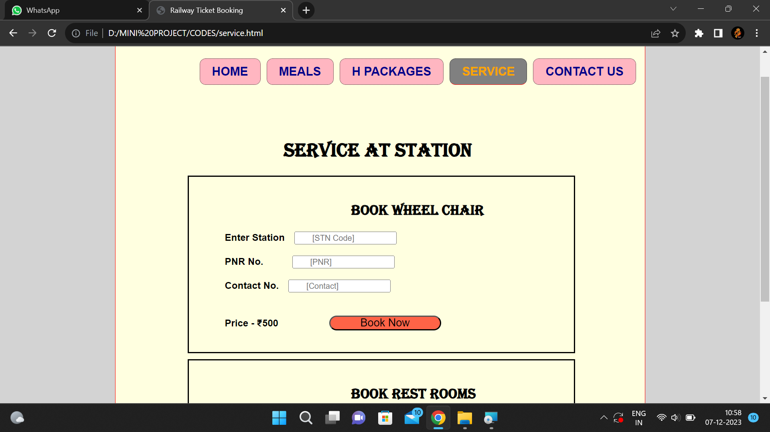

Slide 16
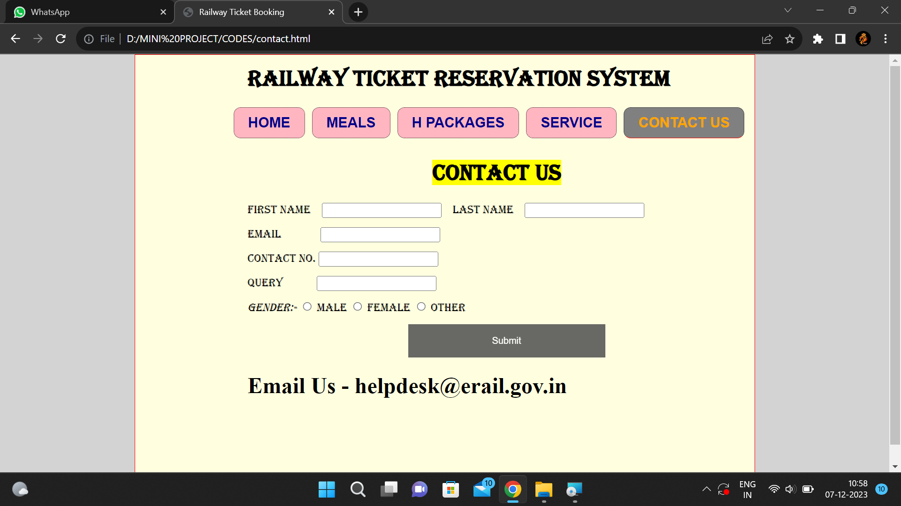

Slide 17
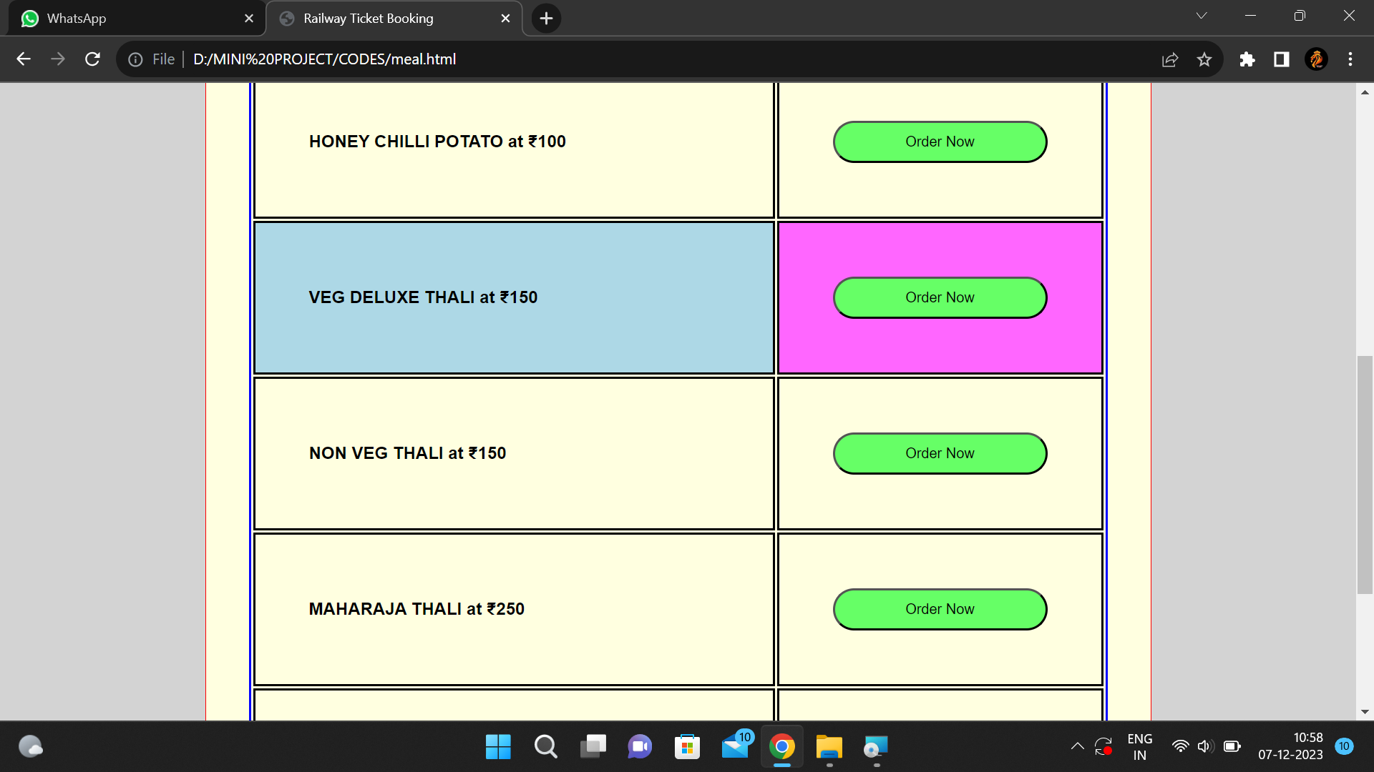

Slide 19
REFERENCES
& SENIORS
& YOUTUBE
& CODE WITH HARRY

Slide 20


